Slide 1
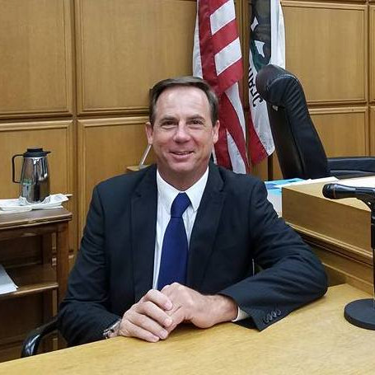
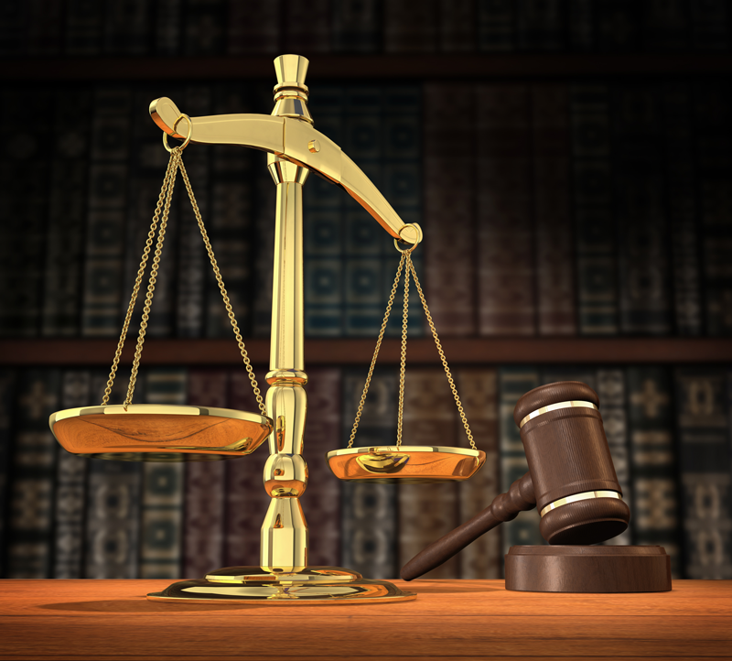
U.S. Legal Writing:
U.S. Department of State
Facilitated By:
Prof. Dr. Daniel Sloan
Notes:
Legal analysis requires that you understand how the law works and how to use it.

Slide 2
Quick Quiz
How many branches of government are there in the United States?
One
Two
Three
Can you name them?

Slide 3
Quick Quiz
How many branches of government are there in the United States?
One
Two
Three
Can you name them?

Slide 4
Legislative Branch
Federal Congress
(Senate and House)
California Legislature
(Senate and Assembly)

Slide 5
Executive Branch
Federal President
California Governor

Slide 6
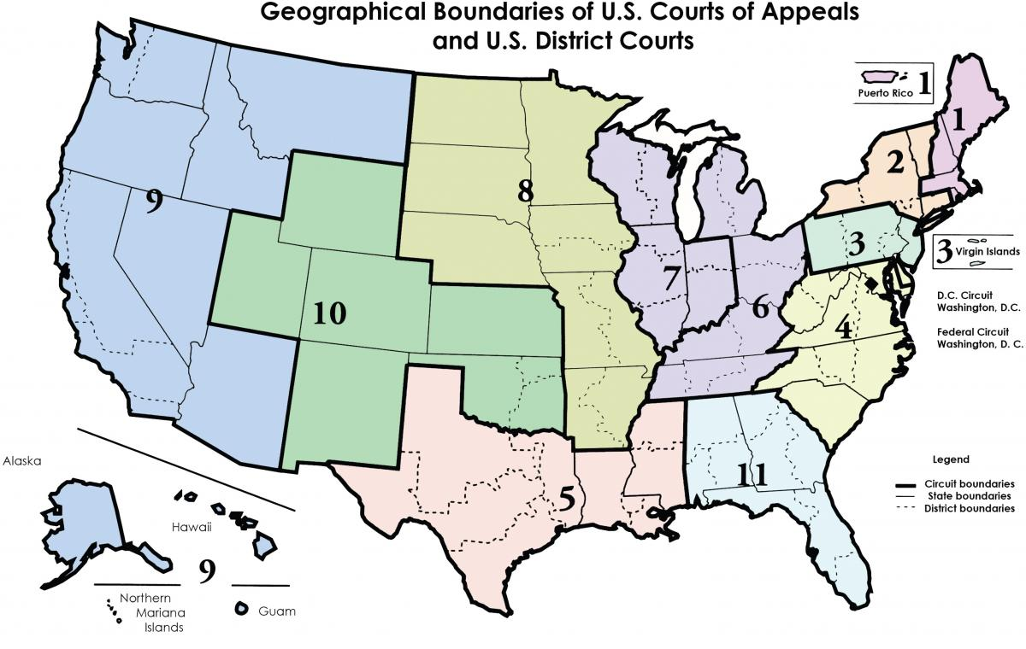
Judicial Branch
FEDERAL
U.S. Supreme Court
Circuit Court
District Courts
Other federal courts (CIT, FedCir.)
STATE
State Supreme Ct
State Courts of Appeal
State Trial Courts
Notes:
So the United States has Federal laws, but the US also has 50 States, and have State Laws.
OTHER FEDERAL COURTS: Bankruptcy Courts
Magistrate Courts
US Tax Court
Court of Federal Claims
Court of Appeals for Veteran’s Claims
Military Courts
Agency Courts: Administrative Agencies (Federal and State
What are Federal cases? They are limited in jurisdiction to what the Constitution allows:
Federal Crimes/ Treaties
Civil suits between citizens of different states: Diversity
Bankruptcy
Review of federal agency decisions or actions
All judges nominated by President, approved by Senate
State courts are courts of General Jurisdiction and decide issues of:
State statutes/ laws
Civil and family issues
Most judges elected
POINT: Federal laws, regs, cases, and then a separate lower system of 50 States’ laws, regs, cases. In each of these systems – jurisdictions – case law is part of the body of law that citizens and courts must follow.

Slide 7
For more info go to https://app-usa-modeast-prod-a01239f-ecas.s3.amazonaws.com/SupremeCourt2019_Hires.png

Slide 8
How would you order the hierarchy?
What are the sources of law?
US Constitution
Statutes
Regulations (administrative)
Judicial decisions (common law, or case law)
Federal and State
Notes:
The U.S. Constitution was created in 1789, with 1791 Bill of Rights, plus more amendments since. The Constitution creates multiple branches of the US Government, divides authority between federal government and states, and grants certain powers to the government, such as the power to “regulate commerce with foreign states, among several states and with Indian tribes.” It also LIMITS the federal govt, such as the 5th Amendment Due Process clause “no person shall be deprived of life, liberty, property without Due Process.” Or our famous First Amendment: “Congress shall make no law respecting an establishment of religion. . . And includes rights of free exercise of religion, freedom of assembly, and free speech.”
1. US CONSTITUTION
Creates multiple branches of government
Divides authority between federal and state government
Gives limited powers to the federal government (Commerce Clause, Due Process Clause, First Amendment)
2. Statutes
3. Regulations (administrative)
4. Judicial decisions (common law, or case law)

Slide 9
Supremacy Clause
If a state law contradicts a federal law, then the federal law trumps and preempts the state law.
Question:
Marijuana is not legal for use by federal law.
Marijuana is legal for limited medical use within 28 in California
Joe is caught with a bag of marijuana in Malibu, and claims it is for medicinal use. Can he be arrested for breaking federal law?
Notes:
It is possible for there to be overlapping laws.

Slide 10
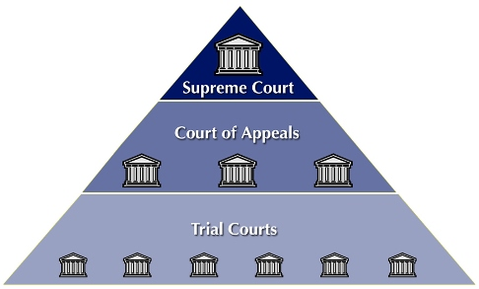
Three levels of courts:
FEDERAL
STATE
Notes:
There are three levels of courts.
The first is trial court. This is where you bring evidence, and there is a jury. At the Federal level it is the federal district court
The second level is the appeal court, which is also called the federal apppellate court.
Then, the U.S. Supreme Court.
Then, there are 50 state courts with the same 3 tier structure.
Every state has its own law! And if it does not conflict with fed law, nothing to force it to harmonize with other states. Different: gun control laws, custody laws, divorce laws, vehicle laws, business laws, professional licensing laws (doctors, nurses, pharmacists, lawyers, accountants), cell phone while driving laws.
This has an Important implication for the way law is taught and learned in the US. In the first year curriculum, Contracts, Torts, Prop, Crim. Primarily based on: (you guessed it) state law. So read cases that come to opposite conclusions on similar questions. Not to learn what IS, but what OUGHT TO BE.
Fed Civ Pro and then the other 2nd year courses like Tax, Constitutional law, Secured Transactions, are primarily federal law. Single unified law mostly. More about learning the law.

Slide 11
Q: At which level is case law made?
A: Appellate level. (This includes the supreme court level.)
Notes:
This is important. Not every case is law. Why not? See next slide.

Slide 12
Binding precedent – stare decisis
Stare decisis means “to stand by that which is decided.” In other words, courts need to follow precedents.
The idea is that precedential decisions should be followed by later courts. This would create consistency and predictability in the law.
Notes:
Answer:
Courts don’t decide cases in a vacuum. They look to what’s come before—other cases with the same legal issue and similar facts that were decided in their governing jurisdiction by an appellate or supreme court.
Courts are required to follow the decisions of higher courts in the same jurisdiction. Accordingly, cases which are both (1) from a higher court, and (2) in the same jurisdiction are considered mandatory authority.

Slide 13
Q: Does that mean all previous cases are precedent?
No.
At the trial court level, decisions are not binding on future litigants or anyone else not before the court.
Even at the appellate court level, not all decisions are binding law. Only published opinions create law.
(The Supreme Court is also an appellate court.)
Notes:
Binding precedent is higher authority from courts in your jurisdiction.
Courts are required to follow the decisions of higher courts in the same jurisdiction. Accordingly, cases which are both (1) from a higher court, and (2) in the same jurisdiction are considered mandatory authority.

Slide 14
Discuss:
Compare and contrast: How do civil law judges use cases?
If cases are not only advisory but mandatory and binding, how will this affect the way they are used by a court?
If case law is binding, how will they be taught in law schools? (Or, if there are new cases being decided every day, how does that affect the way law students learn?)
Notes:
Answers:
Civil law jursidictions (though there are hybrid systems) use cases as advisory, not mandatory. Common law jurisdictions like the US use binding precedent which is higher authority from courts in your jurisdiction.
What that means: Common law judges have less discretion to figure out what the law means, as they are bound by precedent. More predictability, less flexibility for the judge.
In law school: Instead of learning only black letter law, you will need to learn the cases. However because cases will always change, you need to know how to find, understand, and critically synthesize the cases to form the current law. Cannot just look up the code.
This is because in law school, even if you learn the current state of the law, by the time you graduate, that law may have evolved with case law. Thus, you must learn how to find the law, and most importantly, how to synthesize all the codes and cases to figure out what is the current state of the law, and how it should be applied in your client’s case. In law school, your professor will challenge you to think about if these facts are different, how to argue what the law should be.
THUS, IRAC is a way to understand common law precedent so that you can use it to develop your synthesis of what the law is, and how it should be applied to your client.

Slide 15
What is IRAC?
A rubric for legal analysis based on the 5 skills that you need to think like a lawyer.
FACTS
ISSUE
RULE
ANALYSIS
CONCLUSION
Discern which facts are relevant
Spot the issue(s)
Determine the governing law.
Apply the governing law to the facts to generate assessments or arguments.
Use the analysis to make a recommendation to fit your client’s interests and goals.
Notes:
HOW:
When briefing a case, your goal is to reduce the information from the case into a format that will provide you with a helpful reference in class and for review. Most importantly, by “briefing” a case, you will grasp the problem the court faced (the issue); the relevant law the court used to solve it (the rule); how the court applied the rule to the facts (the application or “analysis”); and the outcome (the conclusion). You will then be ready to not only discuss the case, but to compare and contrast it to other cases involving a similar issue.
Before attempting to “brief” a case, read the case at least once.
Follow the “IRAC” method in briefing cases:
Facts*
Substantive facts: what happened?
Procedural FACTS/ History- What is happening in the court process
What court authored the opinion: The US SCt? California Ct of Appeal? The Ninth Circuit Court of Appeals? (Hint: Check under the title of the case: The Court and year of the decision will be given). If a trial court issued the decision, is it based on a trial, or motion for summary judgment, etc.? If an appellate court issued the decision, how did the lower courts decide the case?
Usually you will be reading an appeal of a motion to dismiss? Appeal of summary judgment? Or appeal of final judgment? Is it a writ? Who lost in the lower court?
Issue
What is the question presented to the court? Usually, only one issue will be discussed, but sometimes there will be more. What are the parties fighting about, and what are they asking the court to decide? For example, in the case of the assaulted customer, the issue for a trial court to decide might be whether the business had a duty to the customer to provide security patrols. The answer to the question will help to ultimately determine
Rule(s):
Determine what the relevant rules of law are that the court uses to make its decision. These rules will be identified and discussed by the court.
There may be more than one relevant rule of law to a case: for example, in a negligence case in which the defendant argues that the plaintiff assumed the risk of harm, the relevant rules of law could be the elements of negligence, and the definition of “assumption of risk” as a defense. Application/Analysis:
Most important portion of the brief. How courts apply the rule to the facts and analyze the case. Impt to predict outcomes in future cases involving the same issue. What does the court consider to be a relevant fact given the rule of law? How does the court interpret the rule: for example, does the court consider monetary costs of providing security patrols in weighing the burden of preventive measures? WHY? KEY WOR: BECAUSE. Summarize the court’s rationale in your own words. If you encounter a word that you do not know, use a dictionary to find its meaning.
Conclusion
What was the final outcome of the case? In one or two sentences, state the court’s ultimate finding. For example, the business did not owe the assaulted customer a duty to
provide security patrols.

Slide 16
Why IRAC?
Because cases revolve around legal issues.
Since we have a case law system, with many different cases, we need a way to organize and understand cases.
Useful organizational tool to analyze issues for a legal exam, for a client, or for a court.
Notes:
Because US uses case law, you need IRAC to help you understand and synthesize the cases to be able to (1) tell your client what the law is, then (2) argue to the court what the law should be as applied to your client.
Case law is always about 2 sides. Need to determine what is the issue between them.
You might use IRAC in the following issues:
Assessing the merits of a prospective legal matter
Review of case law
What is necessary to win a case for your client
All aspects of legal writing including case briefs, legal memoranda, appellate brief.

Slide 17
How do we use cases? Analogy and Distinction
Precedent
Your client
Notes:
Take the Bussell case and compare your client, Carlos Catastrophe, who has been bitten by a dog.

Slide 18
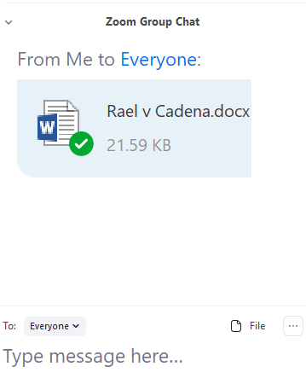
Practice IRAC case brief: Rael v. Cadena
Look in your chat for the document.
Notes:
93 N.M. 684
Court of Appeals of New Mexico.
Eddie RAEL, Plaintiff-Appellee,
v.
Emilio CADENA and Manuel Cadena,
Defendants-Appellants.
Oct. 23, 1979.
Synopsis
Defendant in action for battery appealed from judgment of the District Court, Valencia County, George H. Perez, J., holding him jointly in liable with the active participant. The Court of Appeals, Lopez, J., held that defendant who yelled encouragement to the assailant while the latter was beating the victim was jointly liable with the assailant for the battery. Affirmed.
OPINION
LOPEZ, Judge.
{ 1} Defendant Emilio Cadena, a non-active participant in the battery of plaintiff Eddie Rael, appeals the judgment of the trial court finding him, along with the active participant, jointly and severally liable for the battery. We affirm.
{ 2} The issue on appeal is whether a person present at a battery who verbally encourages the assailant, but does not physically assist him, is civilly liable for the battery.
{ 3} On a visit in Emilio Cadena’s home, Eddie Rael was severely beaten on the head and torso by Emilio’s nephew, Manuel Cadena. As a result of the beating, he suffered a fractured rib and was hospitalized. Eddie Rael testified that once the attack had started, Emilio yelled to Manuel in Spanish, “Kill him!” and “Hit him more!”
The trial court sitting without a jury found that Emilio encouraged Manuel while Manuel was beating Eddie. Based on this finding, the court held the Cadenas jointly and severally liable for the battery.
{ 4} Emilio urges that in order for the trial court to have held him jointly liable for the battery, it had to find either that he and Manuel acted in concert, or that Manuel beat the injured Eddie as a result of Emilio’s encouragement. This is a misstatement of the law.
{ 5} This is an issue of first impression in New Mexico. It is clear, however, that in the United States, civil liability for assault and battery is not limited to the direct perpetrator, but extends to any person who by any means aids or encourages the act. Hargis v. Horrine, 230 Ark. 502, 323 S.W.2d 917 (1959); Ayer v. Robinson, 163 Cal.App.2d 424, 329 P.2d 546 (1958); Guilbeau v. Guilbeau, 326 So.2d 654 (La.App.1976); Duke v. Feldman, 245 Md. 454, 226 A.2d 345 (1967); Brink v. Purnell, 162 Mich. 147, 127 N.W. 322 (1910); 6 Am.Jur.2d Assault and Battery s 128 (1963); 6A C.J.S. Assault and Battery s 11 (1975); Annot., 72 A.L.R.2d 1229 (1960). According to the Restatement: *685 **823 [F]or harm resulting to a third person from the tortious conduct of another, one is subject to liability if he knows that the other’s conduct constitutes a breach of duty and gives substantial assistance or encouragement to the other so to conduct himself. * * * Restatement (Second) of Torts s 876 (1979).
{ 6} Although liability cannot be predicated upon mere presence at a battery, Duke, supra ; 6 Am.Jur., Supra, verbal encouragement at the scene gives rise to liability. Hargis, supra; Ayer, supra; Brink, supra. (A) person may be held liable for the tort of assault and battery if he Encouraged or incited By words the act of the direct perpetrator. * * * (Emphasis added.)
6 Am.Jur., Supra at 108. Because he yelled encouragement to his nephew while the latter was beating Eddie Rael, Emilio Cadena is jointly liable with his nephew for the battery.
{ 7} Contradictory evidence was offered as to whether Emilio Cadena did yell anything during the beating. Eddie Rael claimed that Emilio urged Manuel to beat him; Emilio denied that he said anything; and Manuel testified that he never heard Emilio. However, the trial court found that Emilio did verbally encourage Manuel to beat Eddie. Although the evidence was in conflict, the court could conclude from the testimony of Eddie Rael that Emilio Cadena verbally encouraged his nephew to attack. This testimony, if believed, is substantial evidence to support the trial court’s finding. It is not the function of the appellate court to weigh the evidence or its credibility, or to substitute its judgment for that of the trial court. So long as the findings are supported by substantial evidence, they will stand. Getz v. Equitable Life Assur. Soc. of U. S., 90 N.M. 195, 561 P.2d 468, Cert. denied, 434 U.S. 834, 98 S.Ct. 121, 54 L.Ed.2d 95 (1977).
{ 8} The judgment of the trial court is affirmed.
{ 9} IT IS SO ORDERED.

Slide 19
Break

Slide 20
Student Case Brief: F I R A C
Facts: Case name & citation Procedural Facts (e.g. appeal of summary judgement motion) Legally material historical facts Statement of the case: a short summary
Issue: The question(s) the court must decide. (May be multiple issues and sub-issues.)
Rule: The rule of law on which the court’s bases its decision, e.g. Constitution, statute, FRCP, judge-made law (cases), Restatement, or a combination.
Analysis: The court’s reasoning. The “because” section. May organize into (1) facts and arguments for the plaintiff; then (2) facts and arguments for the defendant.
Conclusion: The court’s holding (what court did legally & procedurally, the result).
Exercise: Write a case brief (FIRAC) for the Rael v Cardena Case

Slide 21
Compare our Case Briefs
Rael (∏ Ap’ee) v. Cadena (∆ Ap’nt), 93 N.M. 684, 604 P.2d 822 (Ct. App. 1979)
Procedural Facts: Eddie Rael sued Emilio and Manuel Cadena for civil battery. Trial court found Emilio jointly liable with Manuel for the battery. Emilio (∆) appealed the judgment of the trial court.
Facts: While visiting Emilio’s home, Emilio’s nephew Manuel beat Rael. After the attack began, Emilio yelled to Manuel “kill him!” and “hit him more!” Emilio never actually struck Rael. Rael was hospitalized.
Issue: Under New Mexico law, can a person be liable for battery when he is present during the battery and encourages the perpetrator of the battery by yelling “kill him” and “hit him more,” even though he takes no actual part in the physical beating?
Rule: Yes. An individual may be liable for battery by encouraging or inciting the perpetrator by words or acts.
Notes:
See also Lucy v Zehmer:
FACTS:
Defendant husband wrote and signed a contract to sell his farm to plaintiffs and persuaded defendant wife to sign by telling her the contract was a joke on plaintiffs. When plaintiffs attempted to finalize sale, defendants attempted to deny contract on the grounds that defendant husband was drunk when making the contract and the contract was a joke on plaintiffs. Plaintiffs sued for specific performance. The trial court found for defendants.
ISSUE:
Was there a valid contract?
Rule:
Yes. RULE:
The mental assent of the parties is not requisite for the formation of a contract. If the words or other acts of one of the parties have but one reasonable meaning, his undisclosed intention is immaterial except when an unreasonable meaning which he attaches to his manifestations is known to the other party.
CONCLUSION:
The Court held that the Defendants' true intent in agreeing to sell their farm was not determinative so long as their words and actions warranted a reasonable person's belief that a contract was intended. Under the objective theory of contracts, plaintiffs reasonably believed the sale contract was a serious business transaction. The evidence suggested defendant husband was not too drunk to know what he was doing.

Slide 22
Sample Student Case Brief
Rael v. Cadena, cont’d
Analysis/Reasoning
Liability for assault and battery extends to a person who aids or encourages the act. The act of verbal encouragement at the scene may give rise to liability because the perpetrator is goaded and encouraged at the behest of the person encouraging the battery. Here, Emilio verbally encouraged Manuel to beat Rael and to continue to beat him. The battery may not have occurred or continued but for Emilio’s encouragement. Therefore, Emilio had some part in the beating even though he never physically contacted Rael. Thus, Emilio is liable for the battery for aiding in its commission and encouraging the act.
Conclusion (holding/disposition): App. Ct affirmed jmt for battery.
Compare these facts:
A person who is not present but inciting the battery via video zoom call.
A person is present but says, “Yeah!”

Slide 23
How (F)IRAC is used:
 | Audience | Purpose | Structure
Case brief | Yourself | To prepare for class and exams | FIRAC
Law Exam Essay | Professor | To demonstrate: 1) your ability to do legal analysis; and to provide a well-written and organized essay | IRAC
Court opinion | Litigants, other judges, lawyers, professors, law students, other branches of government, public | To inform the audience of the holding (outcome) and the reasoning of the case; to persuade that audience of the correctness of the result. | IFRAC
Notes:
Here is a chart that explains how IRAC is used in varying ways, GENERALLY.

Slide 24
Legal Writing Exercises
Be concise
When unclear, put the subject next to the verb (S-V-O)
To help the reader, give signals:
Transitions
Time order
Dovetailing
Parallel construction
Outlines & Titles & Topic Sentences

Slide 25
Edit this sentence to be more concise:
This grievance is not arbitrable because it is excluded from the grievance and arbitration provisions of the parties’ collective bargaining agreement by the express provisions of that agreement, as well as by operation of law of the State of Washington.
This grievance is excluded from arbitration not only by Washington law but also by the parties’ own collective bargaining agreement.

Slide 26
Subject-Verb Distance
A standard form contract that detailed all of the terms of the agreement except for the shipper’s liability was signed by both parties.
Both parties signed a standard form contract that detailed all the terms of the agreement except for the shipper’s liability.

Slide 27
Transitions
Washington courts do not determine nuisance by subjective values. The presence of nuisance is evaluated in objective terms.
Add “Rather,”
Extra:
I am sure that I have the experience and background to contribute significantly to your company. I have been involved in cryptocurrency since college. I speak three languages fluently and have been educated on three continents. Since law school ADR has been my specialty.

Slide 28
Order by Time and Subject (dovetailing)
Having copied financial log books that he took from Mr. Snowadzki’s private desk, Mr. Pugh delivered them to the IRS. Mr. Snowadzki was tried and convicted on two counts of filing false tax returns after the IRS examined the log books Mr. Pugh had delivered.
Mr. Pugh took and copied financial log books from Mr. Snowadzki’s private desk and delivered them to the IRS. The IRS then examined the books and tried and convicted Mr. Snowadzki on two counts of filing false tax returns.

Slide 29
Parallel Construction
The defense counsel elicited that the appellant paid for a listed telephone in his own name, kept some clothes there, and the room was ready for him to be occupied.
The defense counsel elicited that the appellant had paid for a listed telephone in his own name, kept some clothes there, and had a room there that was ready for him to occupy.

Slide 30
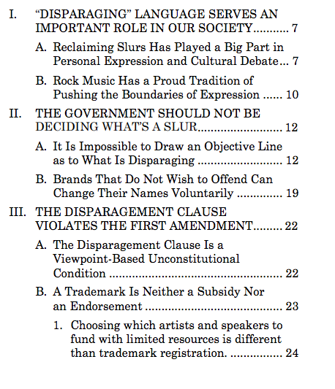
Outlines
An outline can argue your case for you.

Slide 31
Headings and Subtitles
I. WHETHER MR. LEE’S FOURTH AMENDMENT RIGHTS WERE VIOLATED.
This heading poses a question when it should convey a conclusion.
THE OFFICERS VIOLATED MR. LEE’S FOURTH AMENDMENT RIGHTS.
This heading is better because it states a conclusion. However, it would benefit from the inclusion of legally significant facts
I. THE OFFICERS VIOLATED MR. LEE’S FOURTH AMENDMENT RIGHTS WHEN THEY CONTINUED TO SEARCH HIS CAR AFTER HE REVOKED CONSENT.
This example is better because it states a conclusion, provides the court with a reason why that conclusion is correct, and incorporates a legally significant fact.

Slide 32
Topic Sentences
Topic sentences tell the reader what each paragraph is about. Keep your paragraph to 1 idea. Here are some typical ways to start a legal topic sentence:
A Court holding:
In Baldwin, the Court in Washington held that the garage was not part of the inhabitable structure of the home because the lack of an interior door connecting the two reduced the danger to those inside the home.
General Court Holding:
Courts have held that a person can be considered armed with a deadly weapon even when in the act of stealing it. In Crews…
“COURTS-LOOK-AT” Topic Sentence:
To determine if an object is a deadly weapon, courts often look at the surrounding circumstances of its use. Specifically, the Baldwin court looked at such factors as time, place, nature, and…
Application Paragraphs
Unlike the facts in Baldwin, here, the client was not in the act of stealing . . .
Here,

Slide 33
Thank you!

Slide 34
What does a case look like?

Slide 35
Where does the case begin?
Case summary, but not part of actual case
Case Name
Court
Date

Slide 36
Where does the opinion begin?
Case begins after judge’s name
Page
Headnotes

Slide 37
How would we cite this case?
Bussell v. Tri-Cty. Humane Soc., 50 S.W.3d 303 (Mo. Ct. App. 2001).

Slide 38
Law Exam Essays: I R A C
Issue: Articulate the legal question to be answered. You can often find this in the “call of the question.” Then list each sub-issue.
Rule: Articulate the governing law. Note that in essays involving multiple issues or sub-issues, you may have to do multiple IRACs.
Analysis: Apply the law to the facts.
Conclusion: Provide a sub-conclusion for each sub-issue as well as an overall conclusion.

Slide 39
Sample exam question:
Just as the sun is setting on the night of June 14th, Pam sees that the door to Vince's house is ajar. Pam had seen that Vince has a home office in which there is expensive computer equipment. Two weeks earlier, Vince had given notice to his landlord that June 13th was his last day. He was moving out, though he planned to sleep there one more night while he moved things to his new place, for which he had already started paying rent. Pam pushes the unlocked door open, walks into the house and steals Vince’s computer equipment that is valued at well over $5000.
Can Pam be charged for first degree burglary?

Slide 40
Sample law exam answer (Page 1)
Please keep in mind these have been simplified for purposes of this slide presentation.
Issue:
Can Pam be charged for first degree burglary?
General Rule:
The common law requirements for a burglary are that there be: 1) a breaking 2) and entering 3) the dwelling 4) of another 5) at night 6) with the intent to commit a felony therein.

Slide 41
Page 2- Analysis:
As to the breaking element, no actual breaking of the door or lock is necessary for burglary. Thus, here, although the door was ajar and unlocked, Pam’s opening the door was sufficient minimal force to constitute a breaking since the nearly shut door was meant to deter unwanted entry.
As to the entering element, Pam entered the house.
As to the dwelling element, for purposes of first degree burglary, “dwelling” is a place from which you have a settled intent, and are using to sleep. Vince was in the process of moving out when Pam entered. However, because Vince had only notified his landlord but not completely moved all his belongings or turned off his utilities, and planned to sleep there, the house would still be considered his “dwelling” for the purposes of first degree burglary.
Notes:
Notice how methodically each element is proven using the facts provided. Even though something like entering seems self-evident, the fact that the defendant actually crossed the threshold has to be stated in order for the legal analysis to be complete.

Slide 42
Page 3: Analysis (cont’d) and Conclusion:
As to the night element, whether it would be considered night at twilight is determined by whether Vince's face could be discerned in natural light at that hour. Here, Vince’s face could not be discerned, and thus it would be night.
As to the committing a felony element, stealing items worth $5000 is a felony.
Conclusion:
Pam is probably subject to a charge of burglary even though it was not technically nighttime and the door was unlocked.

Slide 43
Court opinions: I F R A C
Issue: Many court opinions begin with a recitation of the main issue or “question presented.” Look for portions of the opinion that identify the issue.
Facts: The opinion will typically provide the materially relevant historical facts, procedural history & posture of the case. If an appellate court, the opinion will also typically explain what was decided in the lower courts.
Rule: The court will next determine the law to be applied. In some cases, the court will simply articulate the governing law. In other cases, the court will need to decide what the law is.
Analysis: The court will apply the law to the facts. In doing so it will typically take care to justify the decision and to address any worthy counterarguments.
Conclusion: The holding. Can be reversing, vacating, or affirming or denying.

